Slide 1
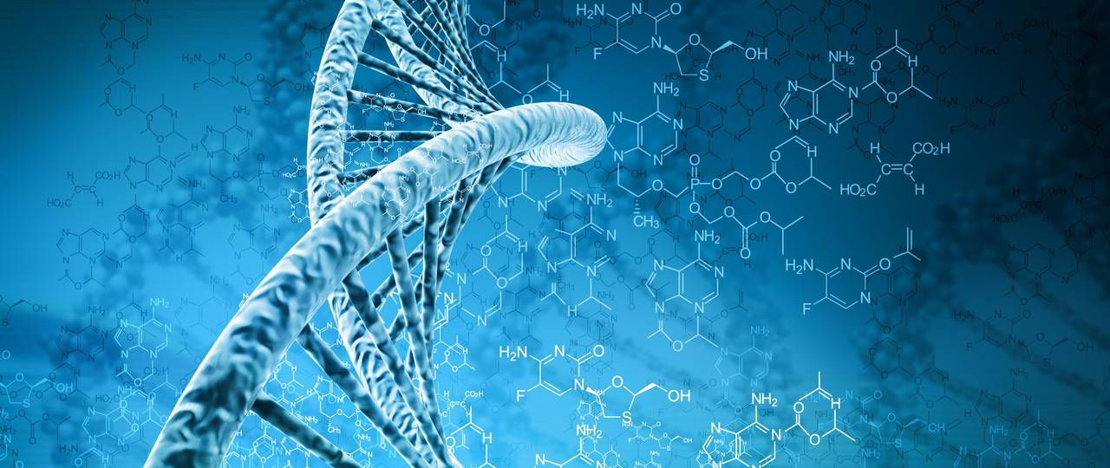
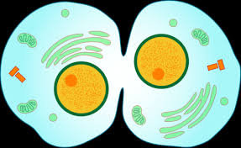
Lab 5:PCR and the Cell Cycle
Note to self: aliquot MM

Slide 2
Lab roadmap
YOU ARE HERE:
Data collection + DNA extraction DUE TODAY
Lab 5 prelab
DUE NEXT WEEK
Lab 6 prelab
DUE WEEK 7
Pre-lab 6
Skills demos (make an appointment to complete these)
DUE WEEK 8
Science communication project rough draft

Slide 3
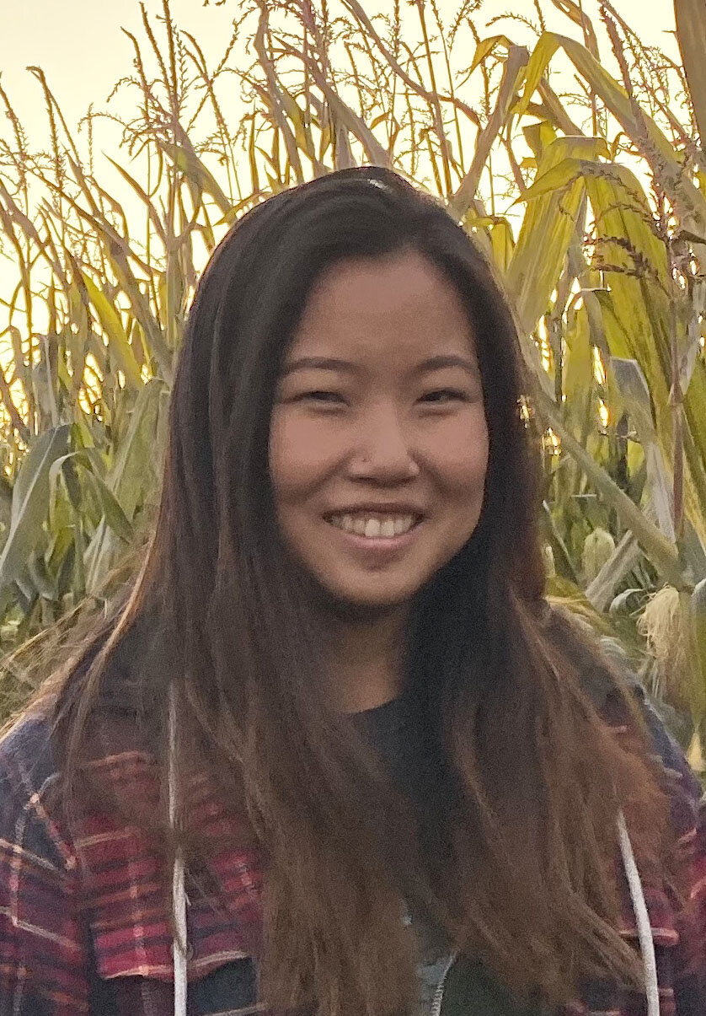
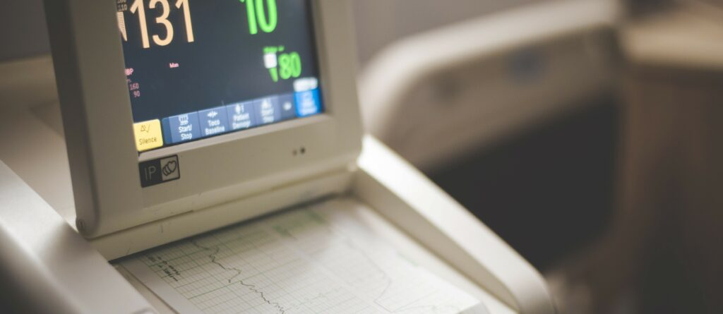
The Wide World of Science!
Turning Data Into Music
Lili Adams 2020 Thesis
Lili Adams was an undergraduate student at OSU in the Maddison Lab, and the main question of her thesis was: If DNA could make music, what song would it sing?
She recorded the sound of the beetle Lionepha’s habitat, the sound of the beetle walking, and assigned tones to the DNA sequence data from multiple genes
Sonification is a growing field for incorporating music into data science
We already communicate scientific information tonally – think of the beeps at a hospital, or ornithologists identifying different birds
Science does not need to be a purely visual medium
https://www.davidmaddisonlab.com/music-video
Notes:
Notes from slide:
Lili Adams was an undergraduate student at OSU in the Maddison Lab, and the main question of her thesis was: If DNA could make music, what song would it sing?
She recorded the sound of the beetle Lionepha’s habitat, the sound of the beetle walking, and assigned tones to the DNA sequence data from multiple genes
Sonification is a growing field for incorporating music into data science
We already communicate scientific information tonally – think of the beeps at a hospital, or ornithologists identifying different birds
Science does not need to be a purely visual medium
Additional Notes
In her thesis, Lili notes that there are still hurdles to overcome in this growing field. “..difficulty when seamlessly communicating science and art. For example, citation formats tend to clash since introductory and conclusive statements are not required when referencing scientific literature as they are for more abstract ideas. It is also difficult to draw a line between personal interpretations in the case of more aesthetic and musical compositions and objective scientific analyses.”
Wanda Diaz Merced is an astronomer who lost her sight due to illness during her career, and as a result was no longer to see the plots of magnetars, the stars she was studying. Magnetars are exploding stars. We can’t see the gamma ray light that is given off by them with the naked eye, we need to use other tools, and often convert readings into numbers, and then into visual plots. Merced worked to convert the same data into sound, and now she can interpret the data. https://www.youtube.com/watch?v=-hY9QSdaReY
Humans can have the innate ability to learn quickly using auditory cues. Pentatonic scale: https://www.youtube.com/watch?v=6XxmyLUaDZo
The sound in hospitals: “In hospital settings, for example, complete silence is often hard to come by. In its place you are more likely to find rooms packed with machines all monitoring information from heart rate and blood pressure to oxygen and fluids, each sending various sounds into the air to alert healthcare workers of any dips or rises that occur. These sounds — whether slow and steady or quick and high-pitched — enable the dissemination of more information across multiple senses, allowing staff to divert their visual sense to one task while monitoring multiple others through their sense of sound.” https://blogs.oregonstate.edu/honorslink/2022/07/11/the-sounds-of-science-turning-data-into-music/
Lili’s thesis: https://ir.library.oregonstate.edu/concern/honors_college_theses/wp988r90d?locale=en

Slide 4
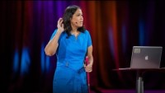
The Wide World of Science!
Turning Data Into Sound
Wanda Diaz Merced
Lost her sight during her career due to illness and was no longer able to see plots of magnetars (exploding stars she studied)
Turned the visual plots used to analyze these stars into sound so she could interpret the data.
Notes:
Notes from slide:
Lili Adams was an undergraduate student at OSU in the Maddison Lab, and the main question of her thesis was: If DNA could make music, what song would it sing?
She recorded the sound of the beetle Lionepha’s habitat, the sound of the beetle walking, and assigned tones to the DNA sequence data from multiple genes
Sonification is a growing field for incorporating music into data science
We already communicate scientific information tonally – think of the beeps at a hospital, or ornithologists identifying different birds
Science does not need to be a purely visual medium
Additional Notes
In her thesis, Lili notes that there are still hurdles to overcome in this growing field. “..difficulty when seamlessly communicating science and art. For example, citation formats tend to clash since introductory and conclusive statements are not required when referencing scientific literature as they are for more abstract ideas. It is also difficult to draw a line between personal interpretations in the case of more aesthetic and musical compositions and objective scientific analyses.”
Wanda Diaz Merced is an astronomer who lost her sight due to illness during her career, and as a result was no longer to see the plots of magnetars, the stars she was studying. Magnetars are exploding stars. We can’t see the gamma ray light that is given off by them with the naked eye, we need to use other tools, and often convert readings into numbers, and then into visual plots. Merced worked to convert the same data into sound, and now she can interpret the data. https://www.youtube.com/watch?v=-hY9QSdaReY
Humans can have the innate ability to learn quickly using auditory cues. Pentatonic scale: https://www.youtube.com/watch?v=6XxmyLUaDZo
The sound in hospitals: “In hospital settings, for example, complete silence is often hard to come by. In its place you are more likely to find rooms packed with machines all monitoring information from heart rate and blood pressure to oxygen and fluids, each sending various sounds into the air to alert healthcare workers of any dips or rises that occur. These sounds — whether slow and steady or quick and high-pitched — enable the dissemination of more information across multiple senses, allowing staff to divert their visual sense to one task while monitoring multiple others through their sense of sound.” https://blogs.oregonstate.edu/honorslink/2022/07/11/the-sounds-of-science-turning-data-into-music/
Lili’s thesis: https://ir.library.oregonstate.edu/concern/honors_college_theses/wp988r90d?locale=en

Slide 5
Lab 5: Lab background

Slide 6
Lab Objectives
Demonstrate the ability to use molecular biology skills including PCR and using micropipettes.
Explain the steps of PCR.
Demonstrate an understanding of DNA replication and PCR.
Describe how DNA is organized during cell cycle and meiosis.
TLDR: demonstrate PCR skills and knowledge, understand the processes of mitosis and meiosis
Notes:
Lab objectives = what to study

Slide 7
Experimental Timeline
Last Week:
DNA Extraction + Lysis Buffer
Incubation
This Week:
Amplify (make lots of copies of) DNA
What is the purpose of the lysis buffer?
What do we need to amplify DNA?
Notes:
Use this slide as an interactive way to discuss the timeline
Briefly summarize or ask someone in the class to summarize what we did last week
Prompt them to discuss/answer what the lysis buffer does. Why did we do this step? Answer: to get DNA out of the cells
This week, we’ll amplify DNA. Ask students what we need to do this?
We’re searching for answers like: polymerase, dNTPs, primers (basically the components of master mix) and a cycle of heat/cool (thermocycler)
You can also use this moment to discuss why we need 2 different primers (forward/reverse)

Slide 8
Master Mix - Basic Ingredients
PCR Buffer
dNTPs
Forward primer
Reverse primer
Taq polymerase
dH20

Slide 9
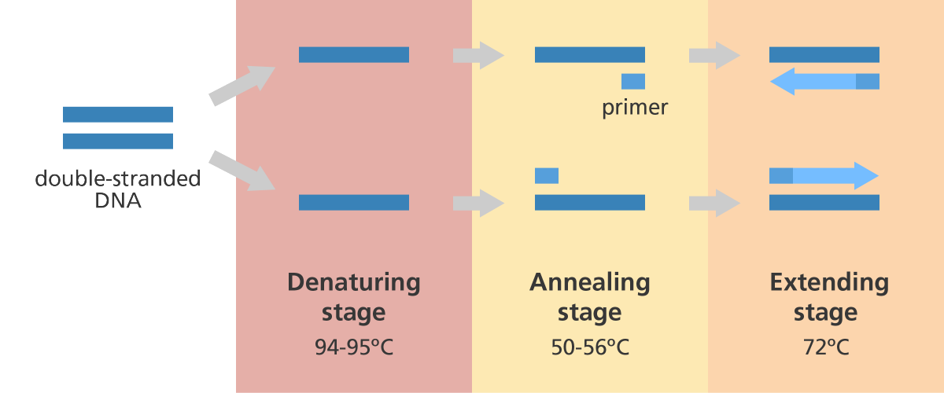
Polymerase Chain Reaction (PCR)
PCR Cycle
Thermal Cycler
Notes:
PCR is a method widely used to rapidly make millions to billions of copies (complete copies or partial copies) of a specific DNA sample, allowing scientists to take a very small sample of DNA and amplify it (or a part of it) to a large enough amount to study in detail.
The majority of PCR methods rely on thermal cycling. Thermal cycling exposes reactants to repeated cycles of heating and cooling to permit different temperature-dependent reactions – specifically, DNA melting and enzyme-driven DNA replication.
PCR employs two main reagents – primers (which are short single strand DNA fragments known as oligonucleotides that are a complementary sequence to the target DNA region) and a DNA polymerase. In the first step of PCR, the two strands of the DNA double helix are physically separated at a high temperature in a process called nucleic acid denaturation. In the second step, the temperature is lowered and the primers bind to the complementary sequences of DNA. The two DNA strands then become templates for DNA polymerase to enzymatically assemble a new DNA strand from free nucleotides, the building blocks of DNA. As PCR progresses, the DNA generated is itself used as a template for replication, setting in motion a chain reaction in which the original DNA template is exponentially amplified.
Almost all PCR applications employ a heat-stable DNA polymerase, such as Taq polymerase, an enzyme originally isolated from the thermophilic bacterium Thermus aquaticus. If the polymerase used was heat-susceptible, it would denature under the high temperatures of the denaturation step. Before the use of Taq polymerase, DNA polymerase had to be manually added every cycle, which was a tedious and costly process.^{[3]}

Slide 10
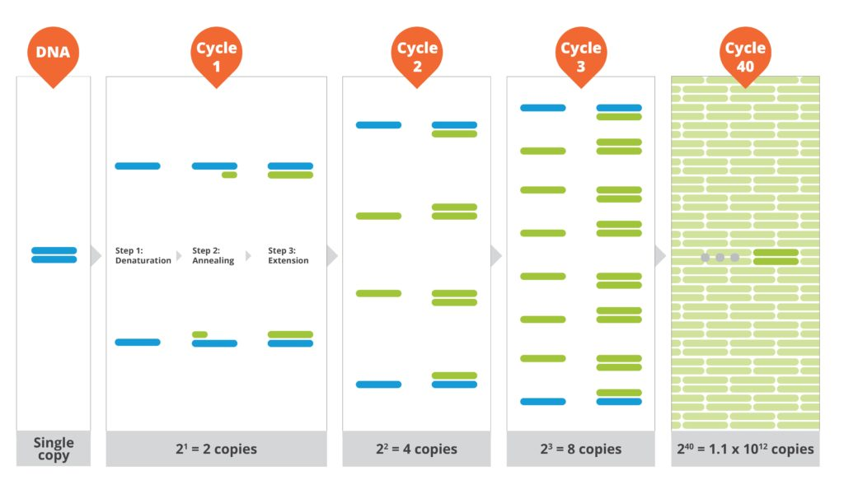
Polymerase Chain Reaction (PCR) : multiple cycles
Denature
Anneal
Extend
Single copy
2² = 4 copies
2³ = 8 copies
2⁴⁰ = 1.1x10¹² copies
2¹ = 2 copies
Notes:
Illustrates exponential growth of cycles

Slide 11
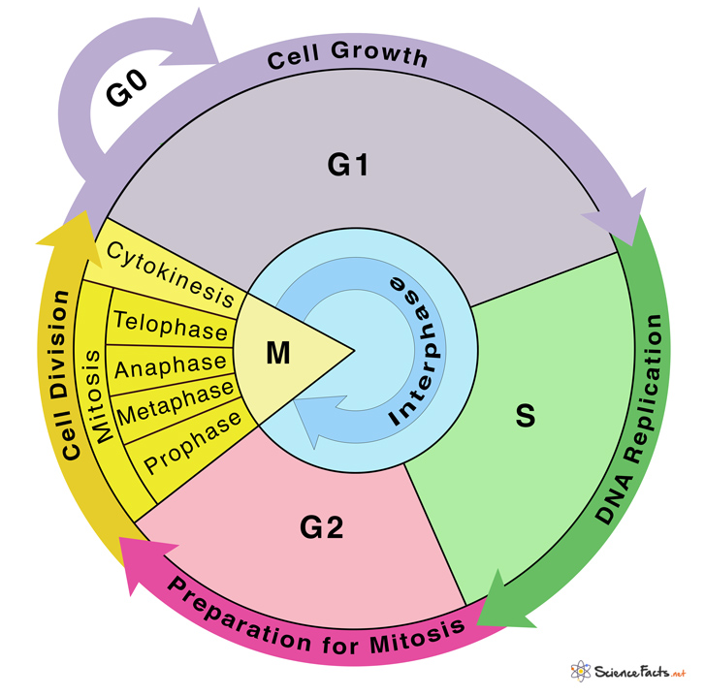
Cell Cycle

Slide 12
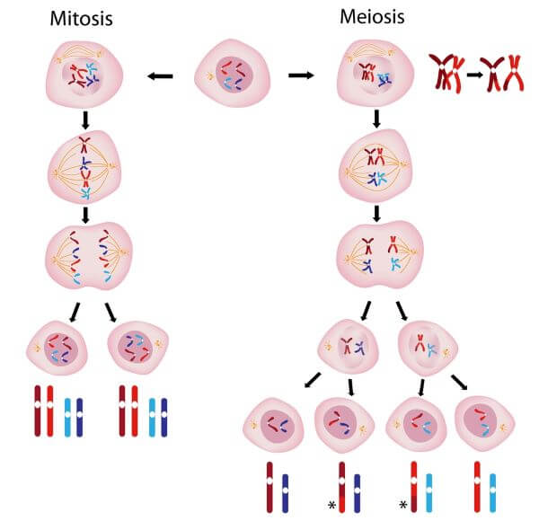
2 sister chromatids
Pairs of sister chromatids (tetrads)

Slide 13
Compare and Contrast
Study Aid
 | Mitosis | Meiosis
What cells undergo this process? | Somatic | Gametic
Does DNA replicate before this process starts? | Yes | Yes
How many times do you go through each stage in a single round of this process? | Once | Twice
Number of resulting daughter cells? | 2 | 4
Proportion of parent’s chromosomes in each daughter cell | All | Half
Number of copies of each chromosome (ploidy) | Diploid (2n) | Haploid (1n)
Genetic similarity of daughter cells to parent cells | Identical | Not identical
Give an example of when this process would happen | Healing from a cut | Producing egg or sperm cells
Notes:
Used to be part of the lab – left in for students to study from.

Slide 14
Lab 5: Today’s activities

Slide 15
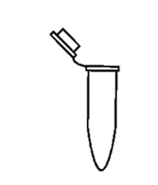
Part 1: Preparation for PCR
Get Master Mix (MM) tube from your TA
Create a new tube for each sample you have.
LABEL THEM!
Create an extra tube that will serve as our blank
Pipette 21 uL of MM in each tube (2 x 10.5 uL)
Pipette 3 uL of DNA to the appropriate tube
Pipette 3 uL of RO (Reverse Osmosis) Water to the blank
Store tubes on ice until we can place them in the Thermocycler
DNA Samples Extracted DNA from last week
Diluted Samples + MM

Slide 16
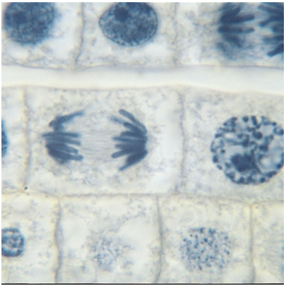
Part 2: Mitosis and Meiosis in the Cell Cycle
Look at an onion root under the microscope & identify cell stages
Use a card simulation to determine the percent of time spent in each stage

Slide 17
Part I: PCR
Page 41 #3: to get 21 µl, pipette 10.5 µl twice so you don’t have to change pipette setting
If you think you don’t have enough MM, try spinning down the tube
Remember pipette skills! Press down slowly to first stop, place tip into solution, release slowly. Move tip to new solution, press down to second stop to eject fluid.
At volumes this small, pressing into that first stop even slightly can have big effects!
Get DNA and Master Mix from TA
Part II: Cell cycle
% of time can be determined by the # of cells in a stage / total cells (cards)
Clean
Used MM and tubes with DNA samples → garbage
Organize group stations, make sure nothing was left on counters
Today’s Roadmap and Tips

Slide 18
Extra slides about sci comm project

Slide 19
Science communication product
Target audience
General public (non-STEM educated)
Citations
Minimum of 3 peer reviewed primary research sources
ESA Frontiers in Ecology and Evolution citation style
Must cite any sources or images used in a citations section
Modules > lab materials and other useful things> Bryan’s citation guide

Slide 20
Science communication product
Must address
A brief description of nematodes and why they are important.
Your question, hypothesis, and prediction (remember what should be in these?).
A basic description of your experimental design, including a clear description of what your treatment/conditions (explanatory variables).
A description of your major results.
A conclusion that ties your results back to your question, hypothesis, and prediction, as well as to other peer reviewed literature.

Slide 21
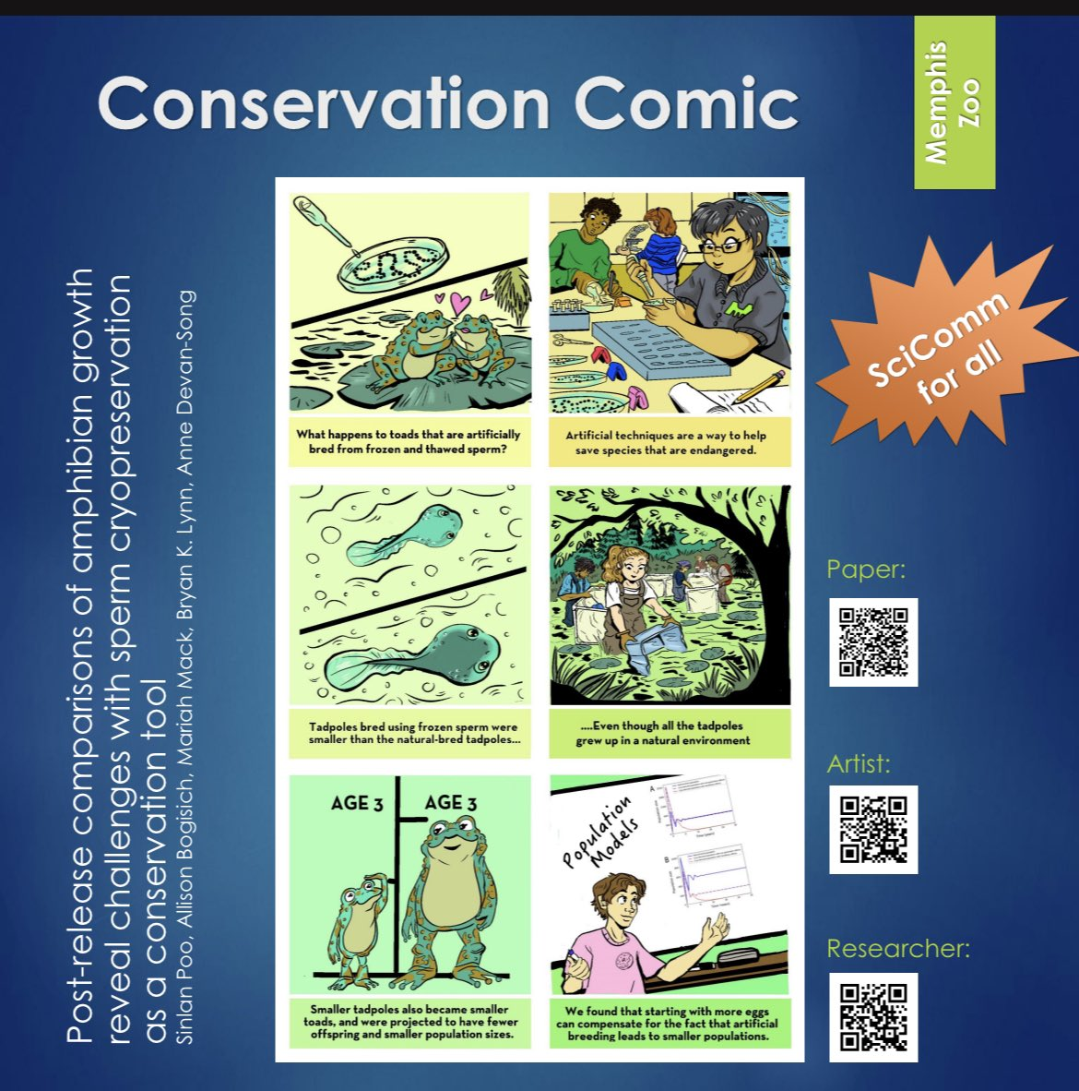
Term Project (individual)
Digital Media
Short video
Animation
‘TikTok’ style
Webpage
Illustrated submission
Pamphlet
Graphic Novel
Other audio/visual
Song
Art

Slide 22
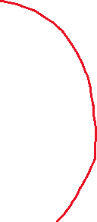
Term Project (individual)
Digital Media
Short video
Animation
‘TikTok’ style
Webpage
Illustrated submission
Pamphlet
Graphic Novel
Other audio/visual
Song
Art
Notes:
If doing an ‘other’ item, they will likely want to make a video of it and the requirements will need to follow the guidelines for a short video. For 2D art, it could follow pamphlet rules minus the formatting.

Slide 23

Science communication product
Format: Pamphlet
Must include:
Illustrations and/or Diagrams
2 pages (= 1 double sided pamphlet)
Not more than 400 words

Slide 24
Science communication product
Format: Graphic novel
Must include:
Narrative/Story
Illustrations
5-8 pages recommended

Slide 25
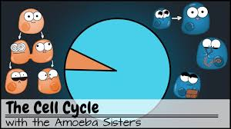
Science communication product
Format: Short Video
Must include:
Informative figures or images
Narration
2- 4 min in length

Slide 26
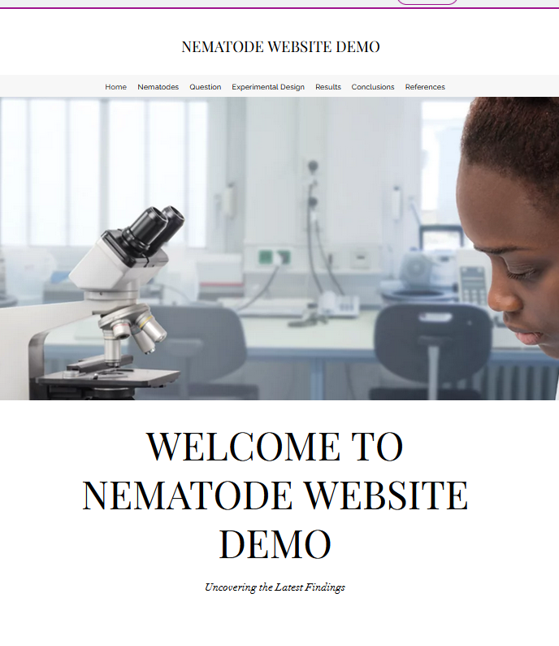
Science communication product
Format: Webpage
Must include:
Homepage
Subpage for each of the 5 topics that need to be addressed
Illustrations/diagrams/video clips or other visual elements on each subpage

Slide 27

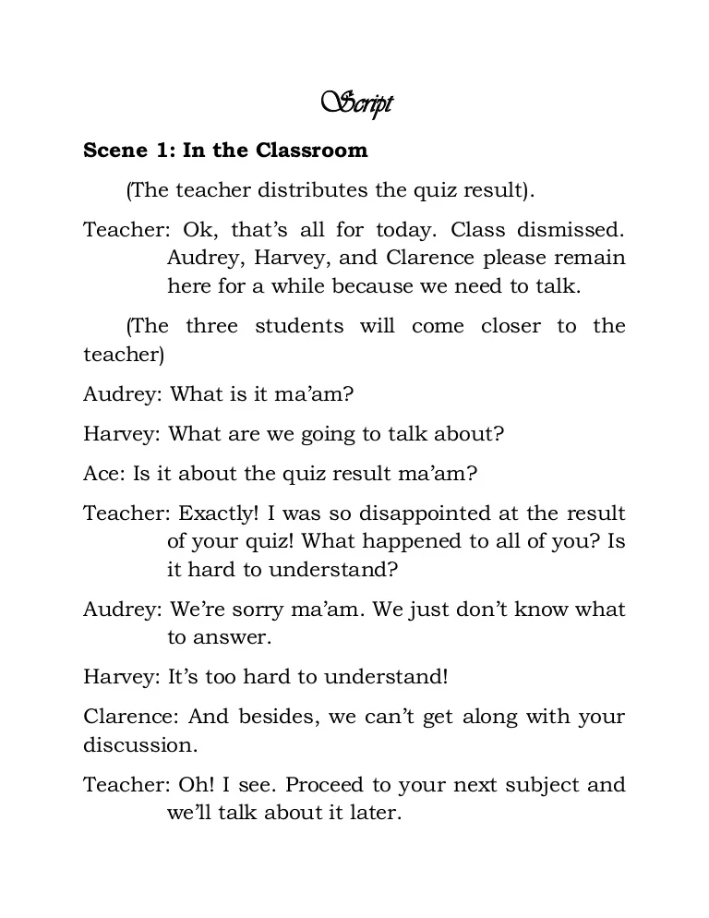
Science communication product
TurnItIn
Create a text transcript that includes all the written or spoken words
Submit to the appropriate Transcript assignment on Canvas (one for draft and one for final product).
Check your score and adjust as needed until <30%
Update product to match any changes to transcript

Slide 28
General tips/remarks
Be clear and concise
It doesn’t need to be long, it just needs to contain all the required information.
Length is flexible, effort is what matters.
Put effort into the visual aesthetics, the goal is to be engaging!
Pay attention to rubric and assignment description
Citations should be primarily in description (part 1) and conclusion (part 5) sections.

Slide 29
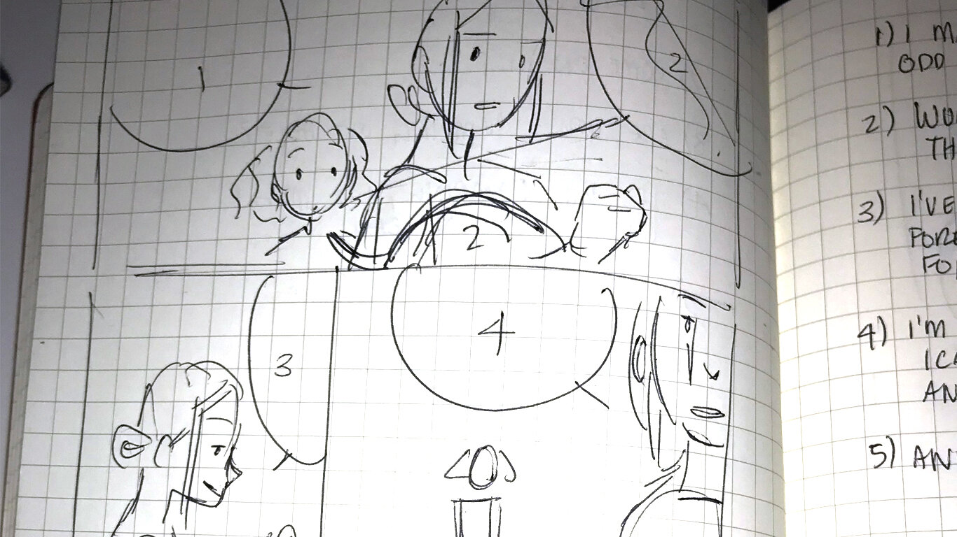
Draft expectations
Text or transcript including:
description of nematodes
question, hypothesis, prediction
experimental design
Detailed outline or sketch of the overall project
should have sufficient details so that the representation of each required component is included

